Slide 1
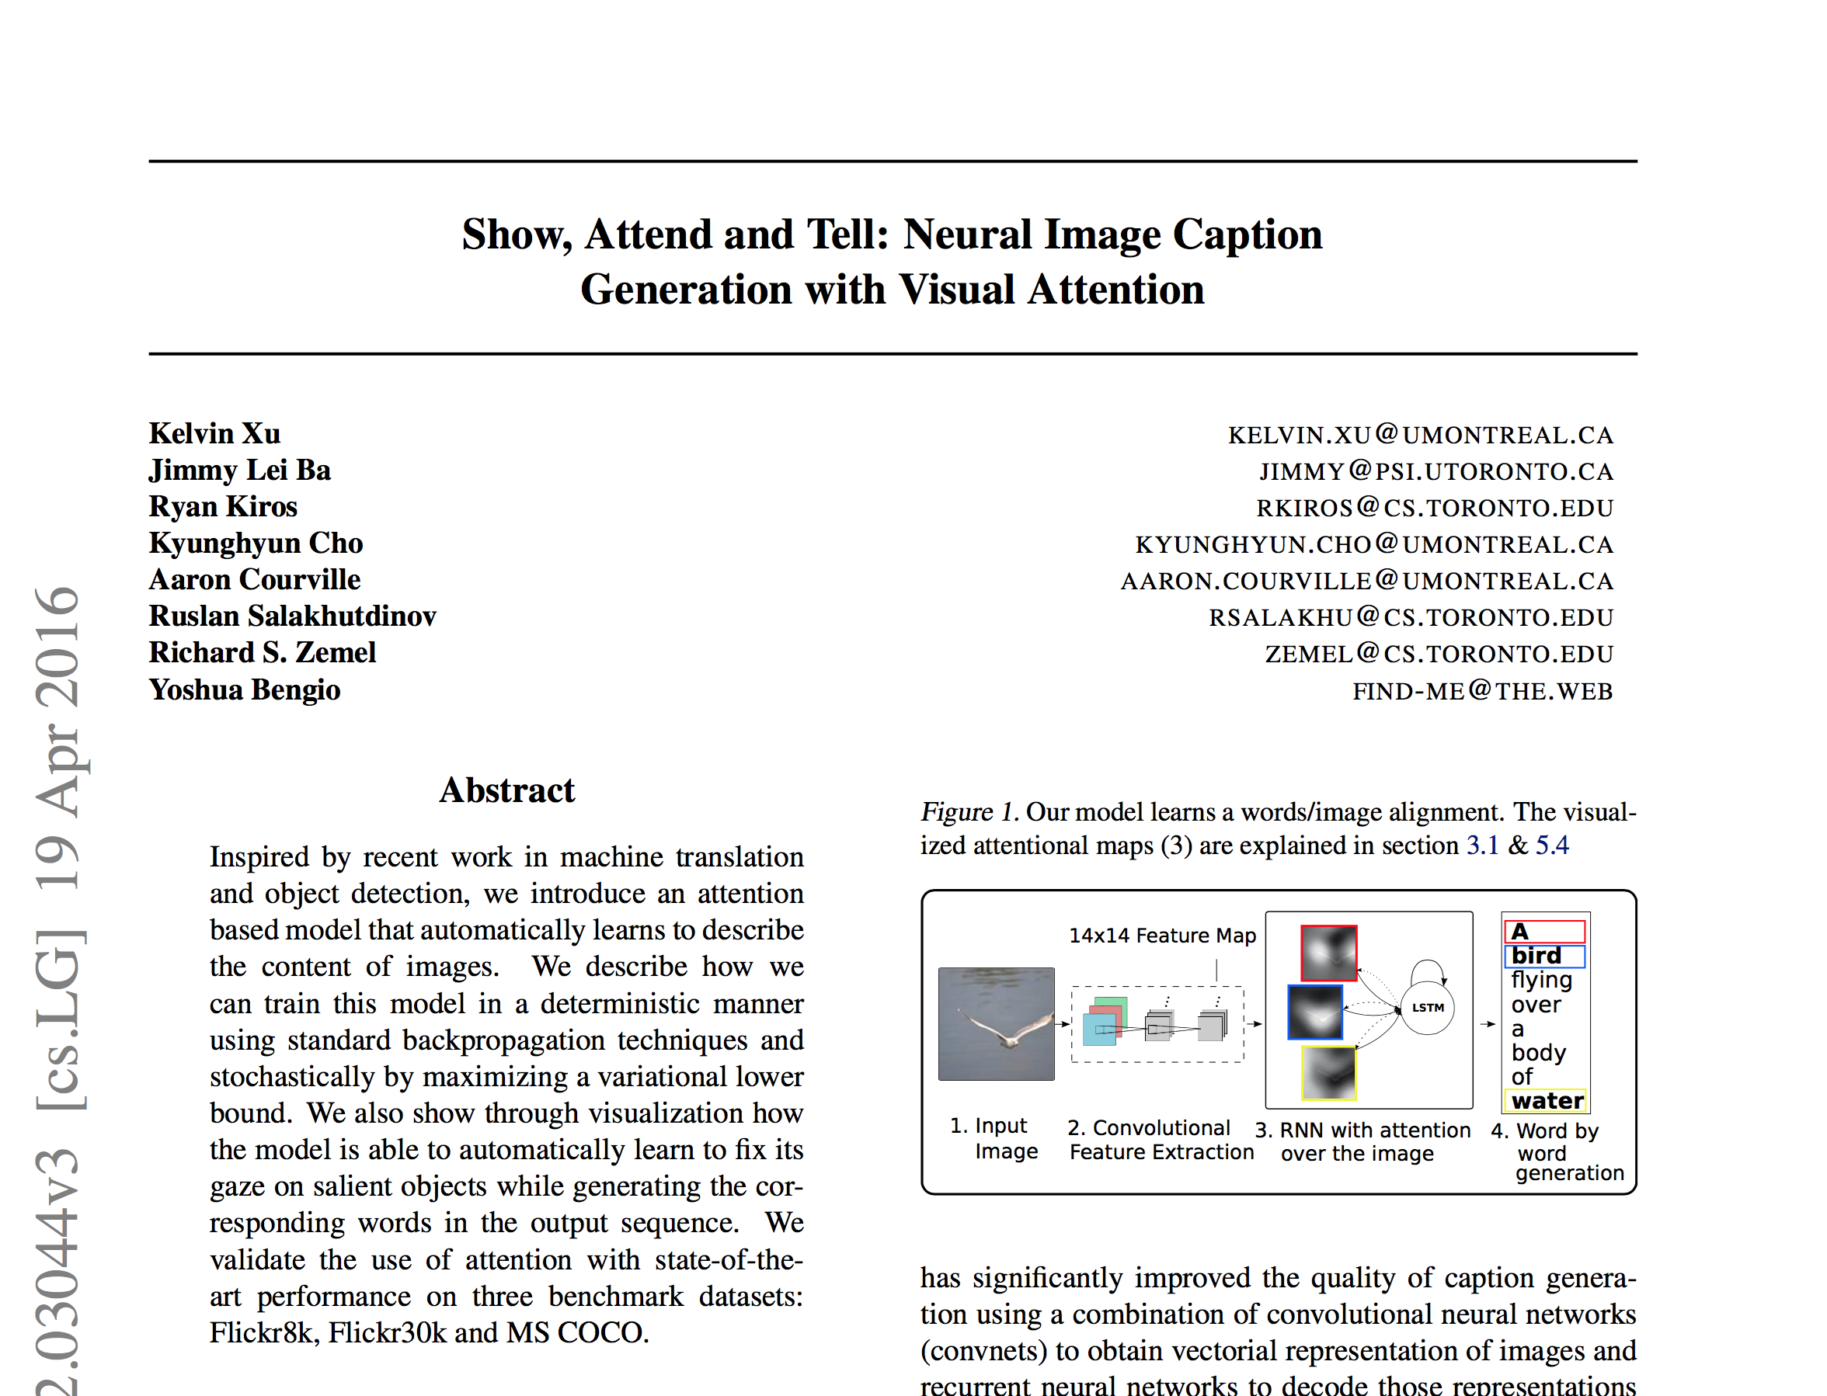

Slide 2
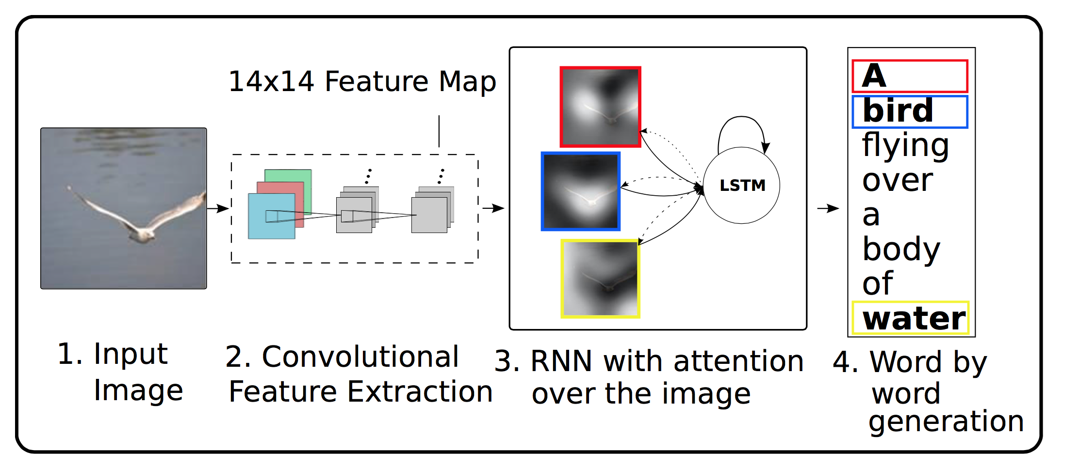
Show, attend and tell

Slide 3
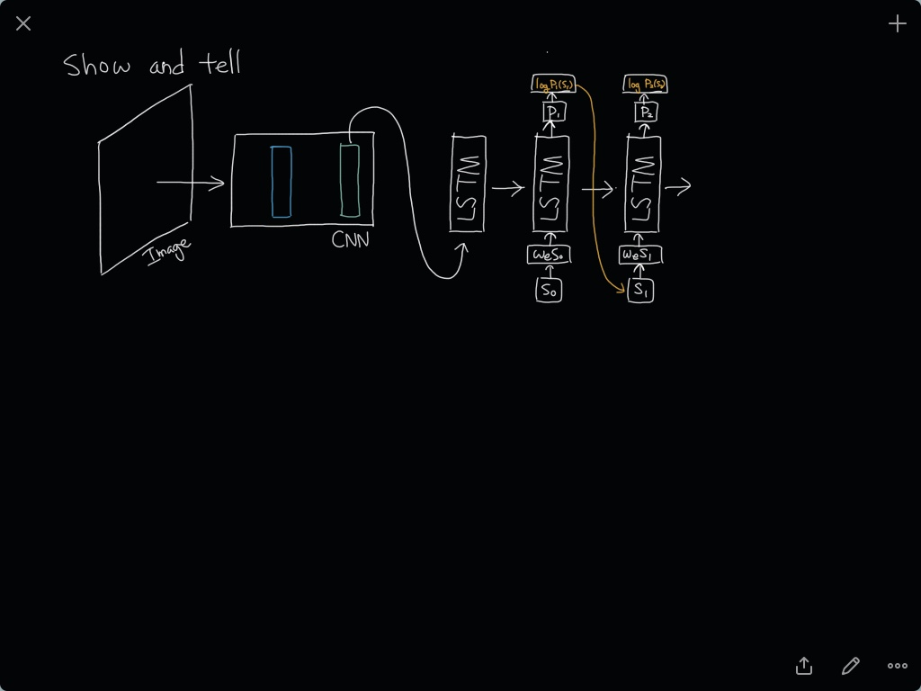

Slide 4
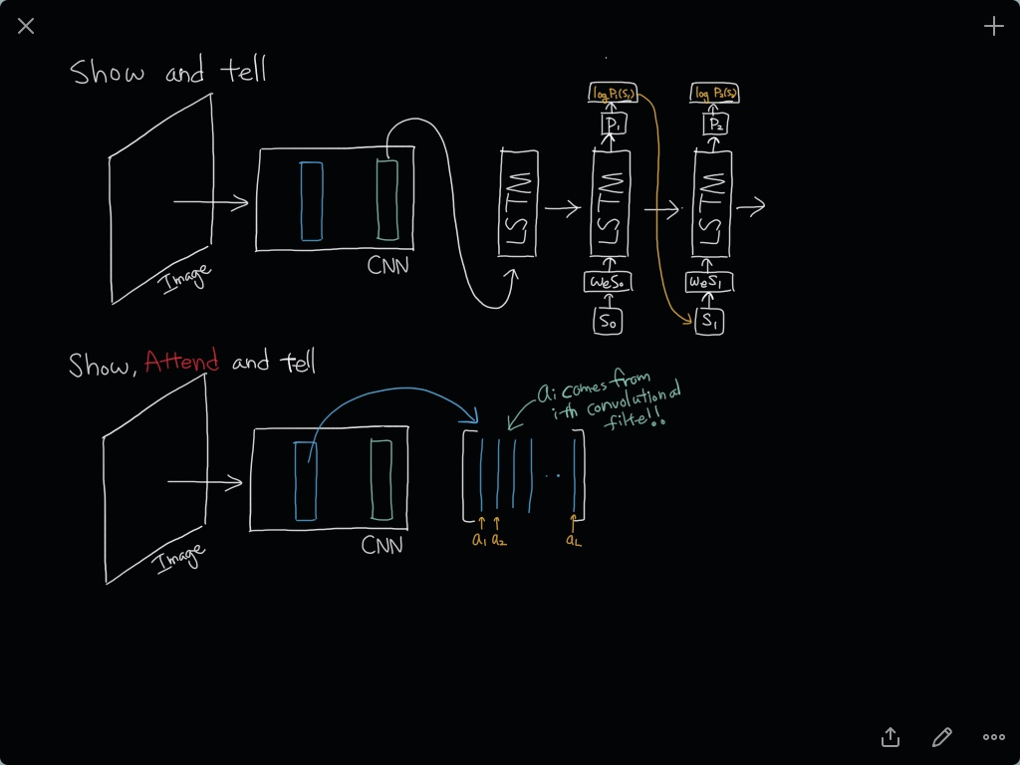

Slide 5
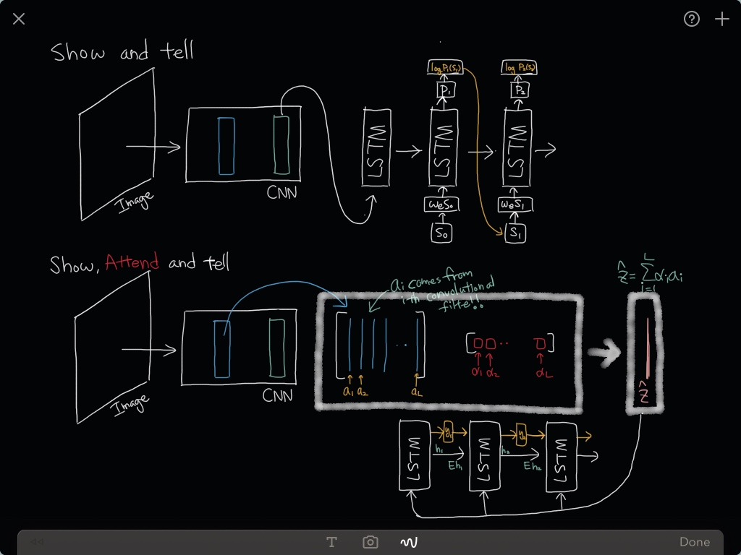

Slide 6
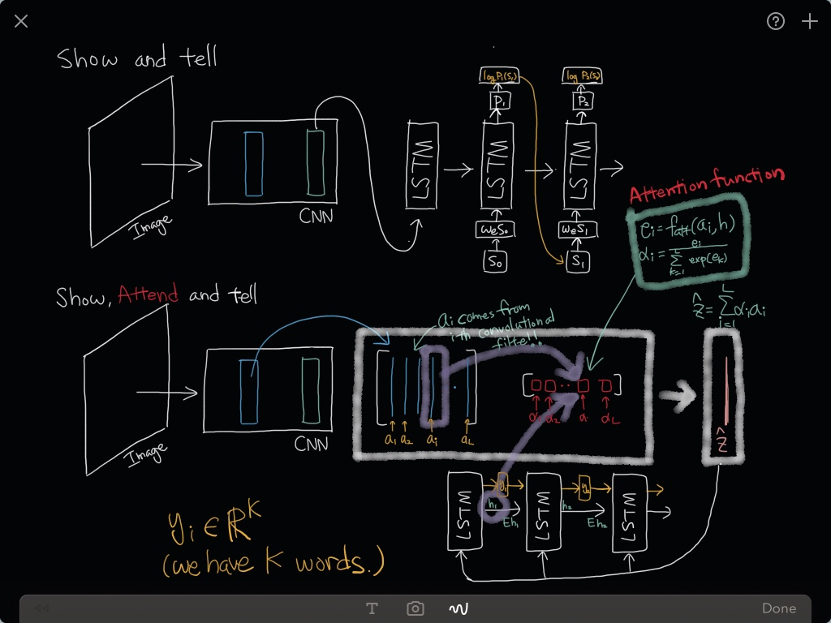

Slide 7
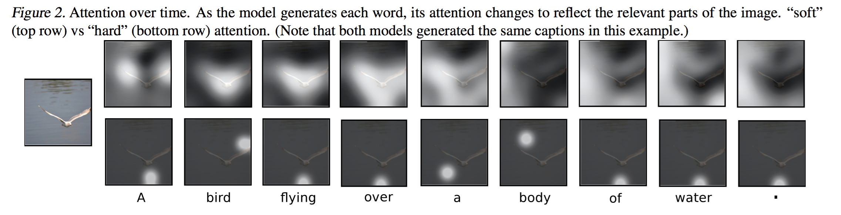
Results

Slide 8
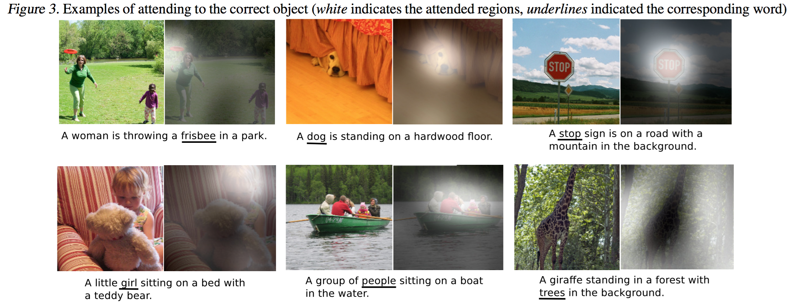
Results

Slide 9
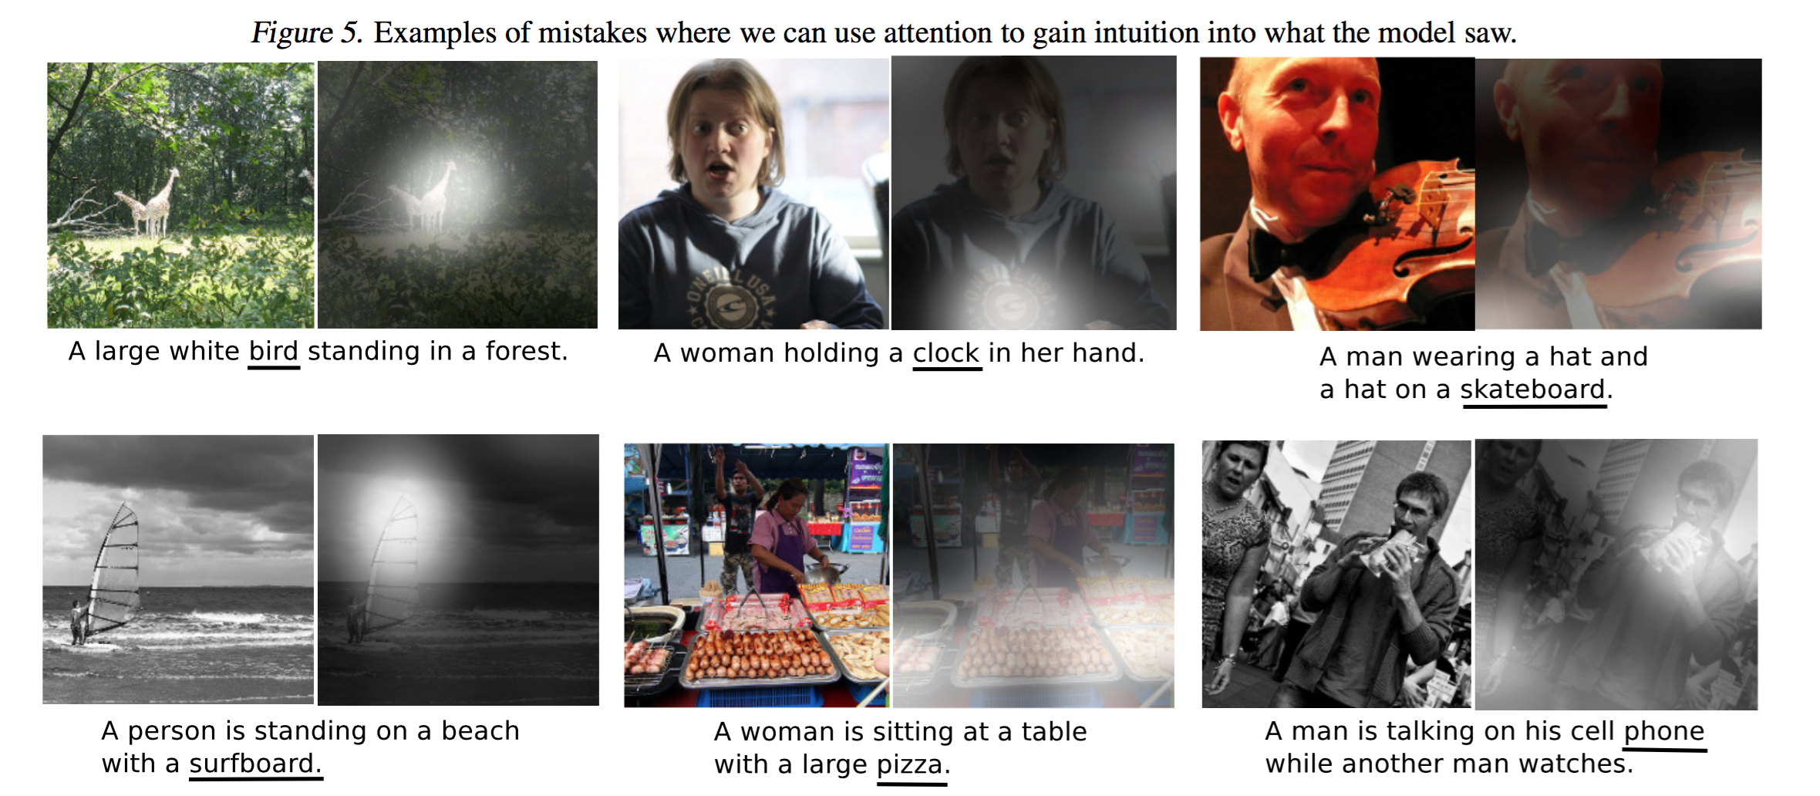
Results (mistakes)

Slide 10
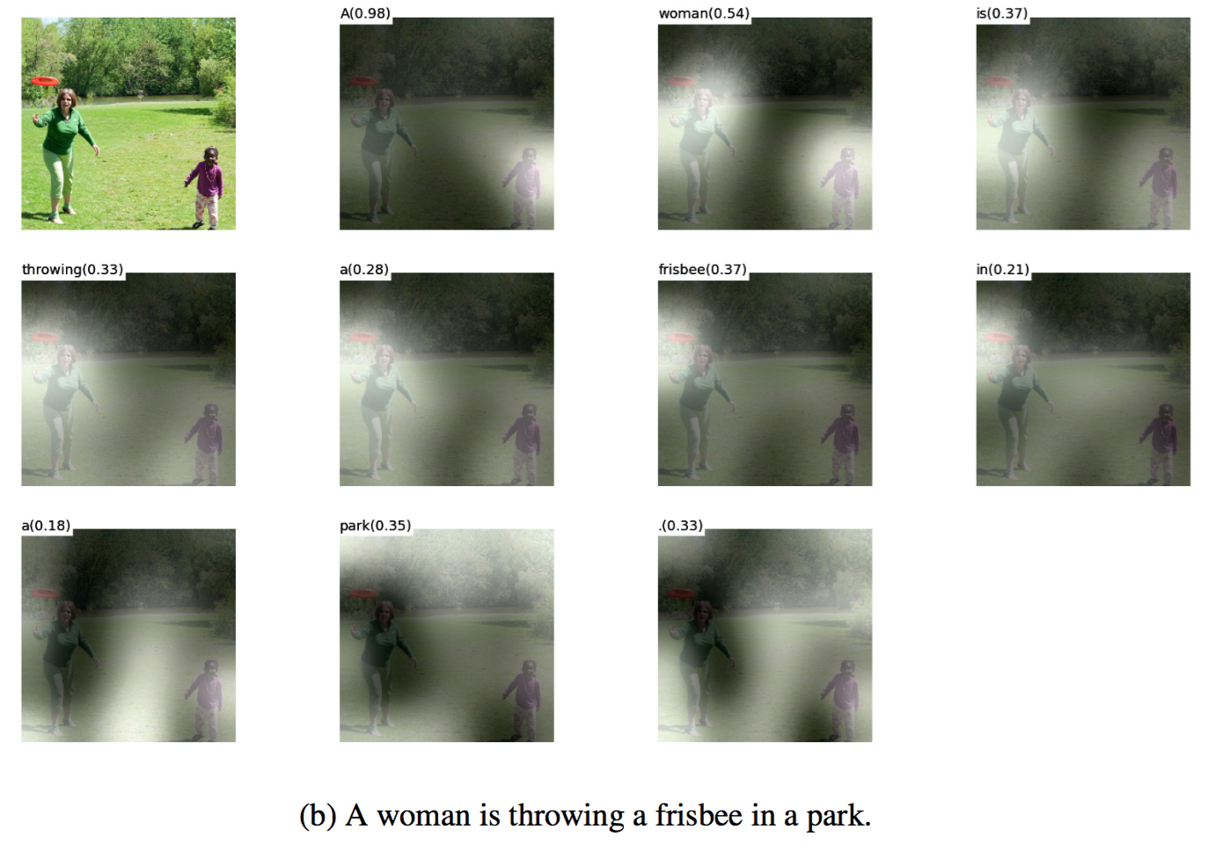
Results

Slide 11
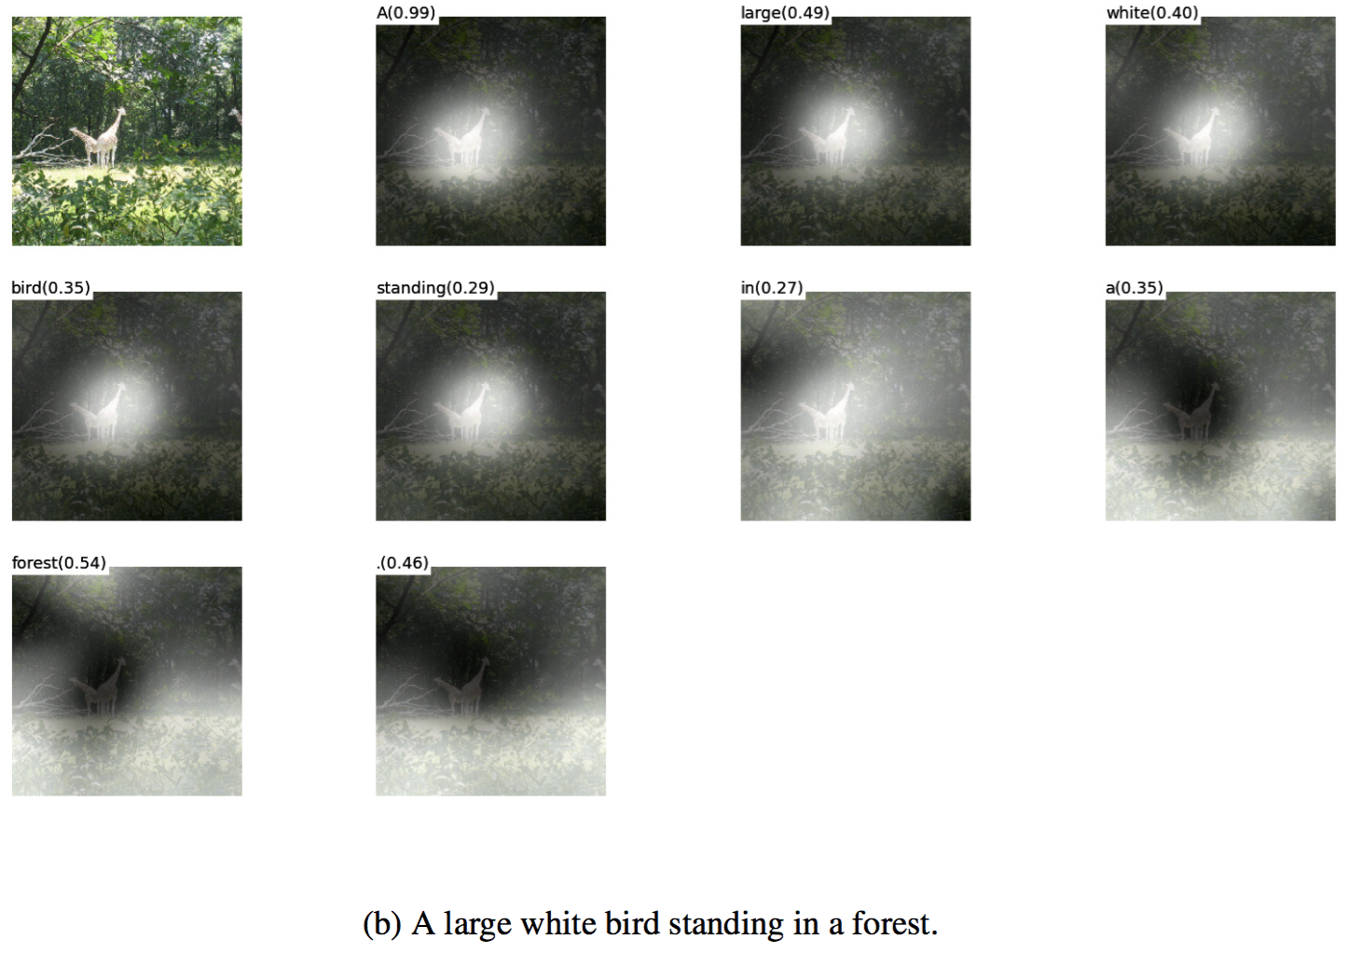
Results

Slide 12
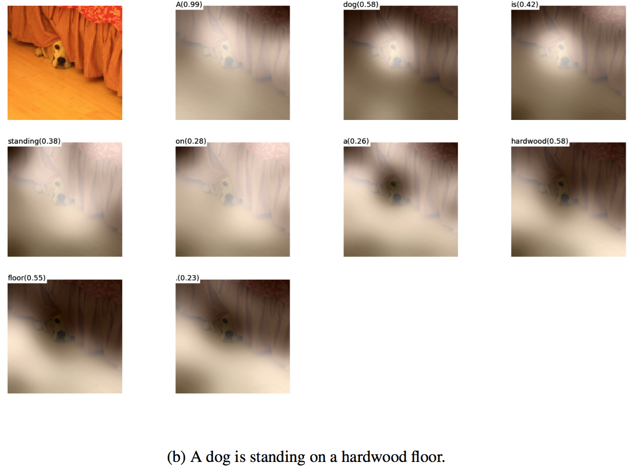
Results

Slide 13
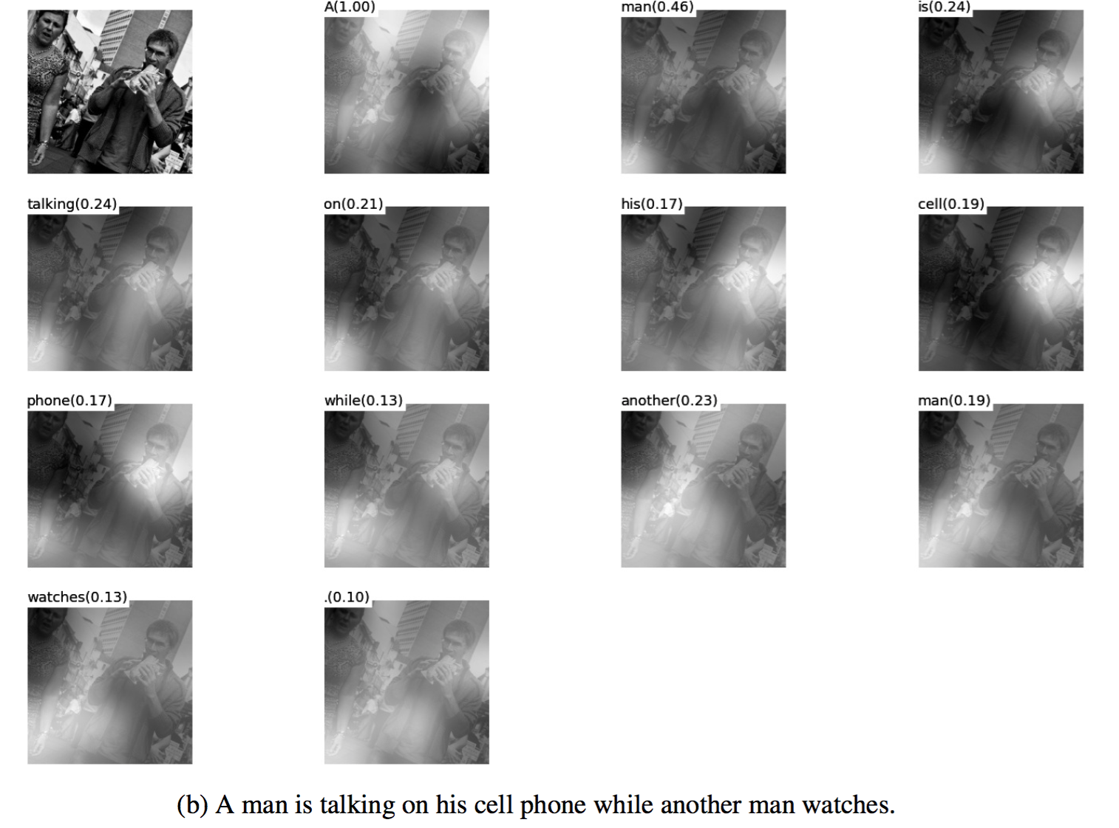
Results

Slide 14
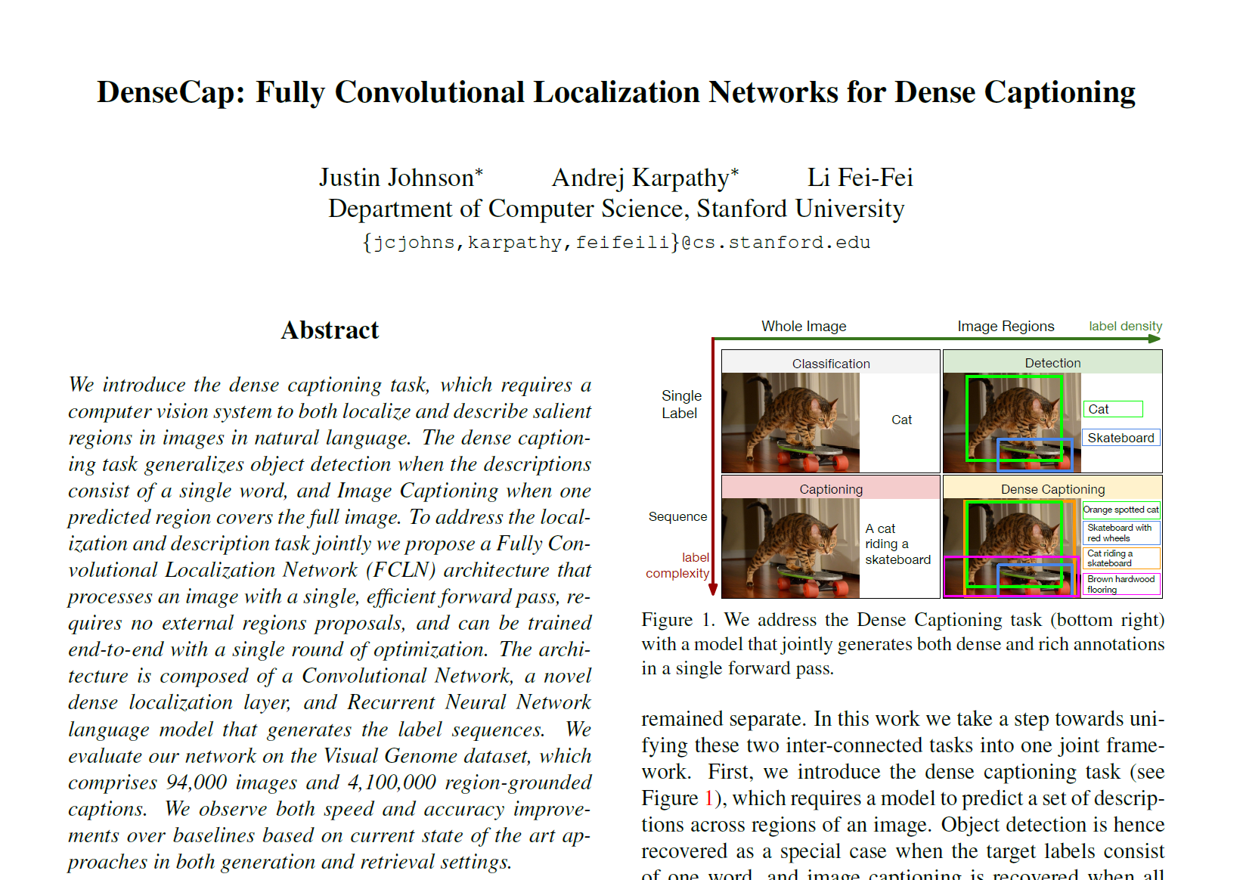
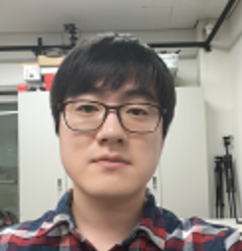
DenseCap
From TA Chang’s slide

Slide 15
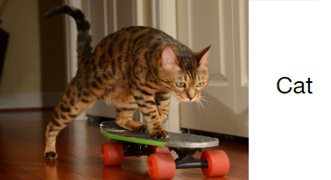
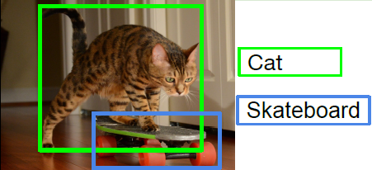
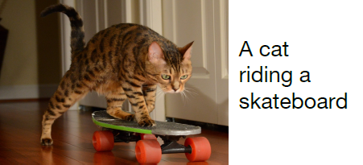
Introduction
Classification
Object Detection
Image Captioning

Slide 16
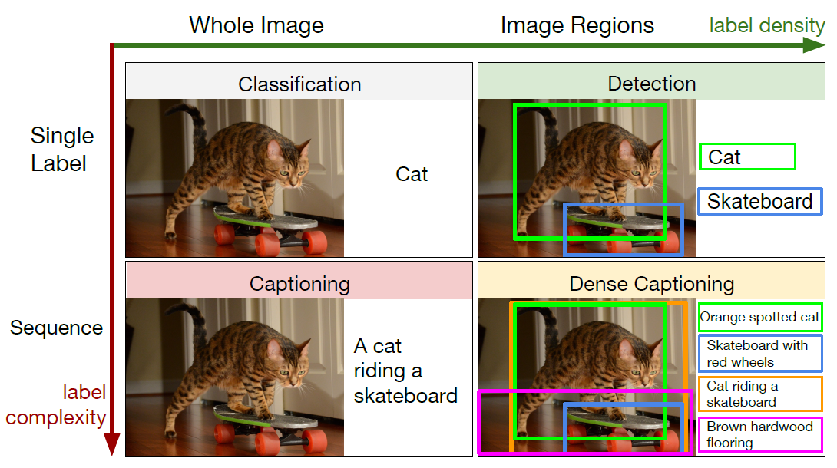
Introduction

Slide 17
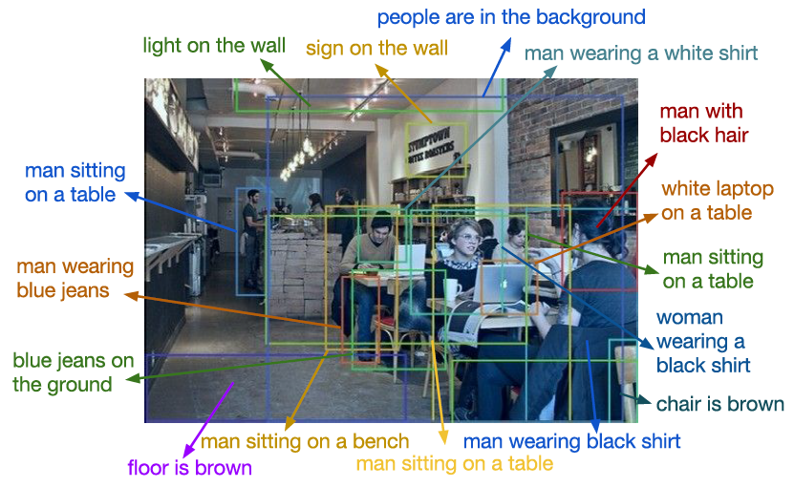
Examples of DenseCap

Slide 18
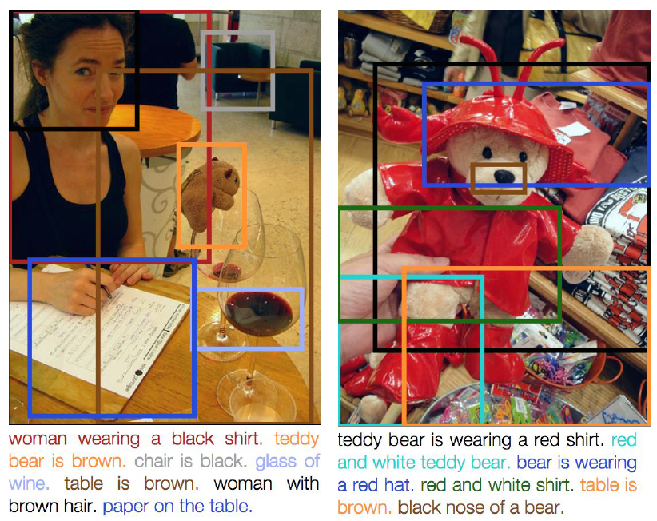
Examples of DenseCap

Slide 19
Contribution
Combine nicely three recent work in
Object detection
+ Image captioning
+ Soft spatial attention

Slide 20
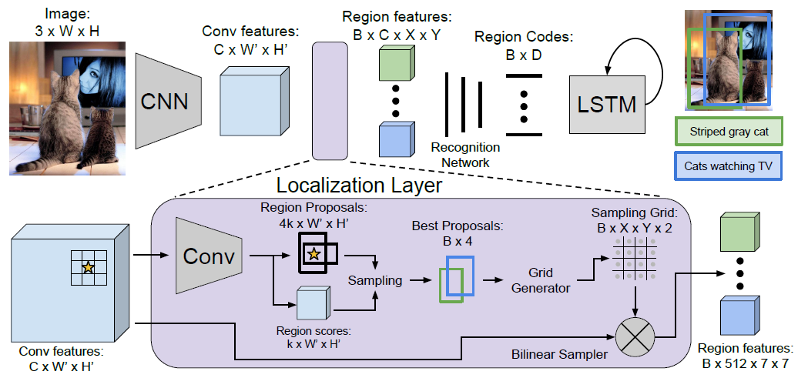
Proposed model
Object detection
Image captioning
Soft spatial attention

Slide 21
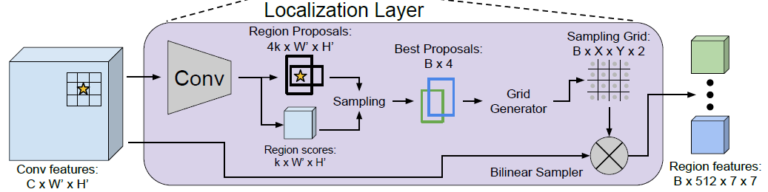
Soft spatial attention
RoI Pulling layer
RPN (Faster R-CNN)
Soft spatial attention
Gradients can be propagate backward from the output features to input features,
But not to input proposal coordinates.

Slide 22
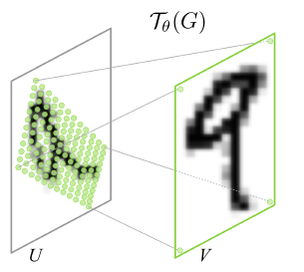
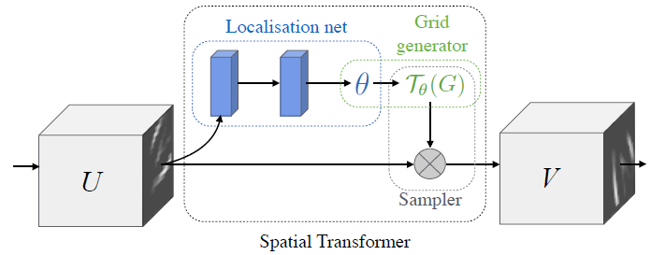
Differentiable image sampling
Jaderberg, Max, Karen Simonyan, and Andrew Zisserman. "Spatial transformer networks." NIPS. 2015.

Slide 23
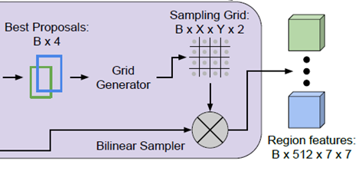
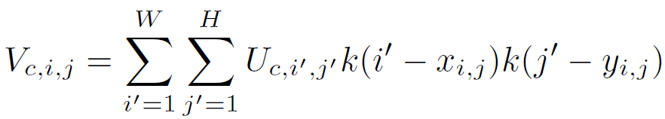
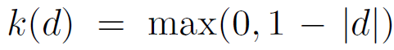
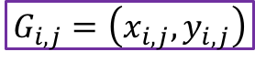
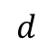
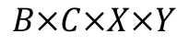
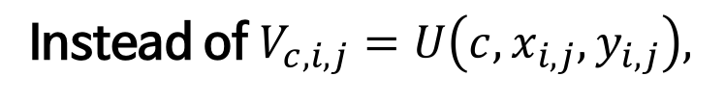
Bilinear interpolation
$$G_{i,j}=\left(x_{i,j}, y_{i,j}\right)$$
Output dimension:
$$B×C×X×Y$$
Instead of $V_{c,i,j}=U\left(c,x_{i,j},y_{i,j}\right),$
1
1
$$d$$

Slide 24
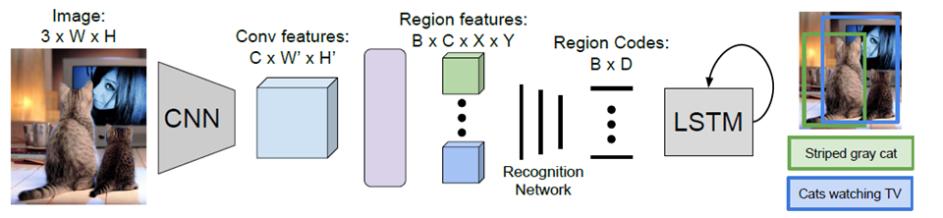
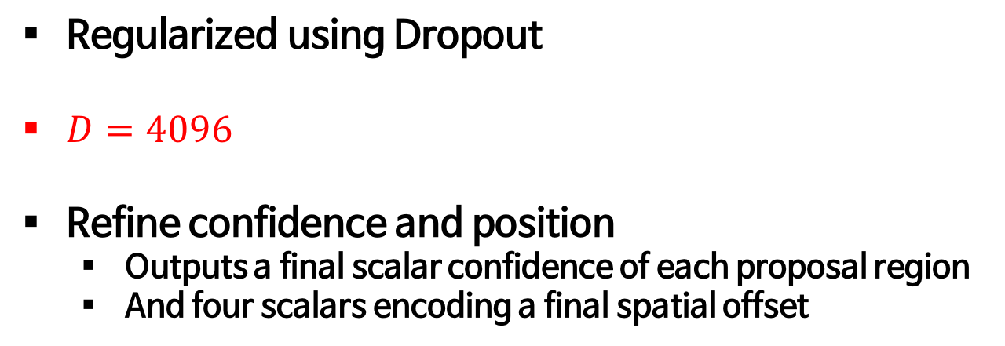
Recognition network
Localization Layer
Recognition Network
Regularized using Dropout
$D=4096$
Refine confidence and position
Outputs a final scalar confidence of each proposal region
And four scalars encoding a final spatial offset

Slide 25
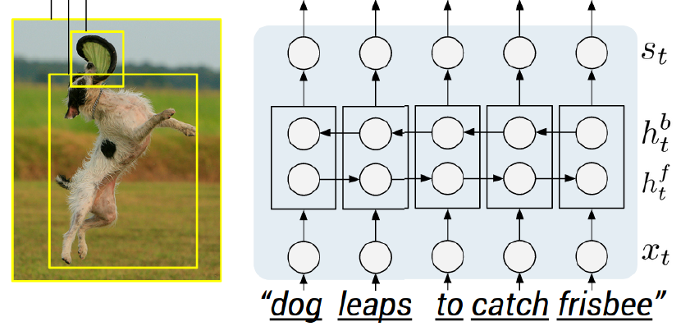
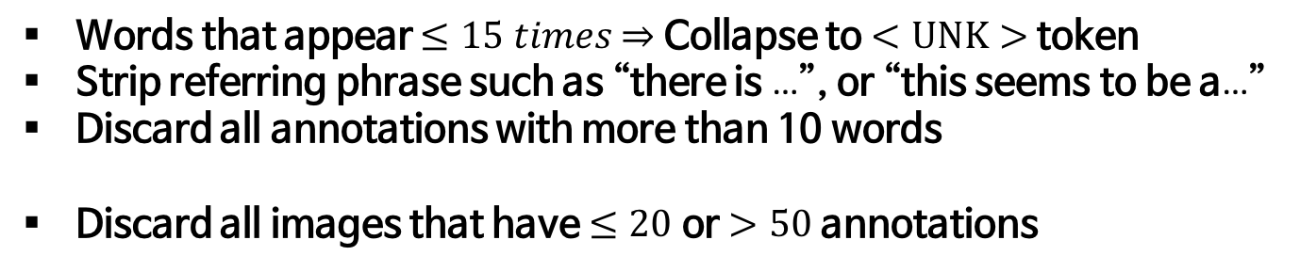
BRNN
BRNN
Words that appear $≤15 times$ $⇒$ Collapse to $<UNK>$ token
Strip referring phrase such as “there is …”, or “this seems to be a…”
Discard all annotations with more than 10 words
Discard all images that have $≤20$ or $>50$ annotations

Slide 26
Proposed architecture
Object detection
Image captioning
RPN (Faster R-CNN)
Soft spatial attention

Slide 27
Examples

Slide 28
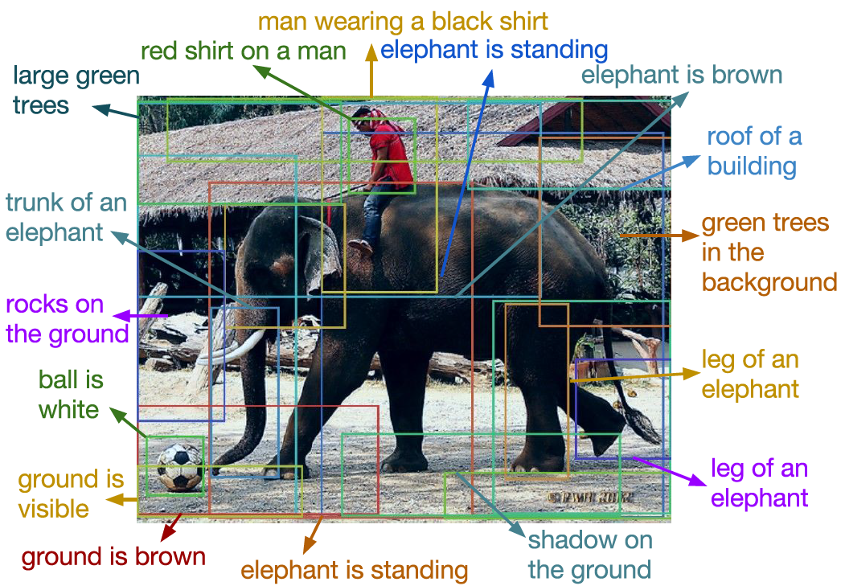
Examples

Slide 29
Examples

Slide 30
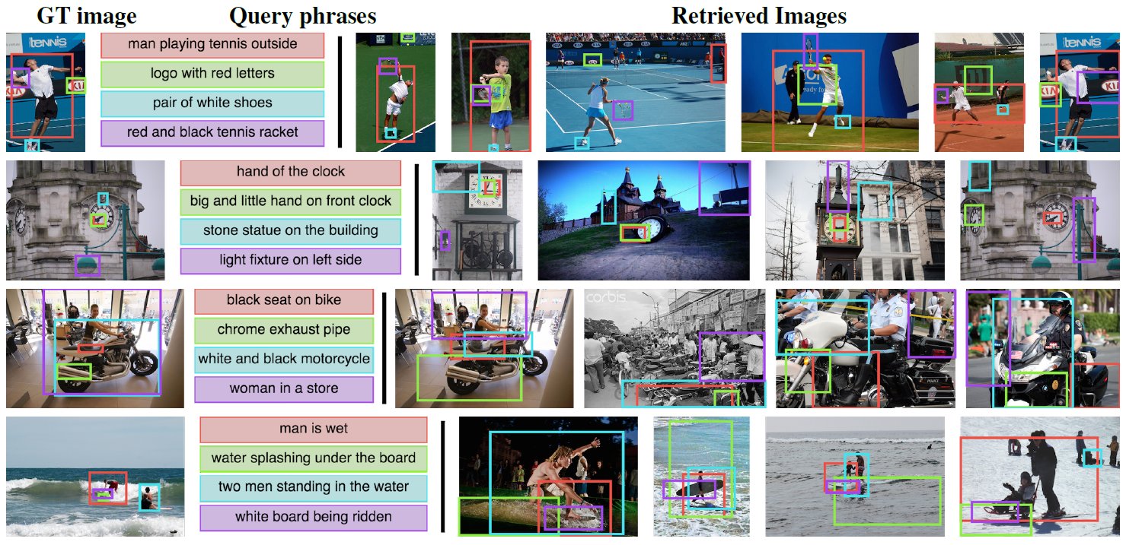
Image retrieval

Slide 31
Open-world object detection

